Slide 1
A History of School Shootings

Slide 2
A gruesome history
Over the course of the past 100 years, there have been at least 46 shootings with multiple casualties, and dozens more with little or no fatalities.

Slide 3
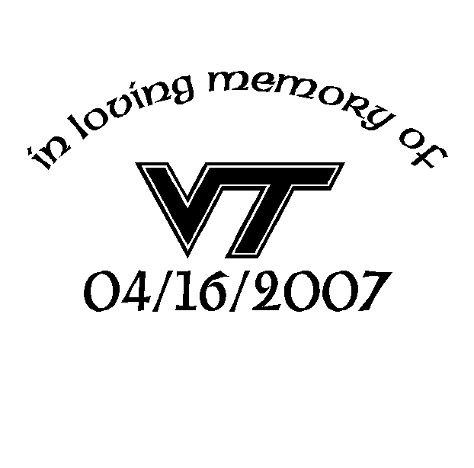
Virginia Tech
32 dead plus the shooter, 16 April 2007, Blacksburg, Virginia
Student Seung Hui Cho, 23, killed two students in a dorm and then went through building of classrooms armed with two handguns, shooting at random before killing himself.

Slide 4
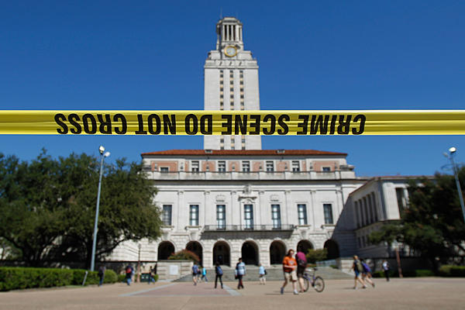
University of Texas
16 dead plus shooter, 1 August 1966, Austin, Texas
Former Marine sniper Charles Whitman, 25, armed with an arsenal of weapons shot victims from the observation deck of the campus tower.

Slide 5
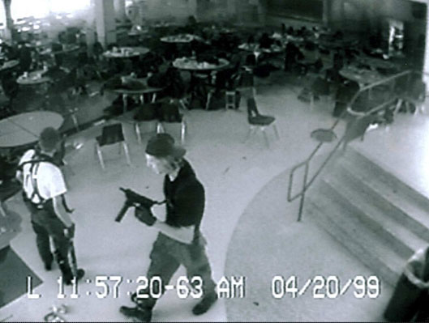
Columbine High School
13 dead plus two shooters, 20 April 1999, Littleton, Colorado
Students Eric Harris, 18, and Dylan Klebold, 17, opened fire outside the school killing students and one teacher before shooting themselves in the library.

Slide 6
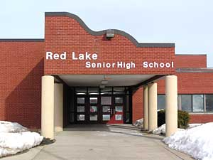
Red Lake High School
9 dead plus shooter, 21 March 2005, Red Lake, Minnesota
Jeffrey Weise, 17, goes on a shooting spree at Red Lake High School killing nine people, including his grandfather, before shooting himself.

Slide 7
University of Iowa
five dead plus shooter, 1 November 1991, University of Iowa
Gang Lu, 27, a graduate student from China killed five with a .38-caliber revolver. He was apparently angry because his doctoral dissertation had not been nominated for an academic award.

